Slide 1
Runtime Coordination of “Mini” Services a practical platform for breaking down the monolith

Slide 2
Background
In his 2014 paper on micro services architecture Martin Flowler proposed “Smart endpoints and dumb pipes.” Microservices (martinfowler.com)
/* add content */
This had lead to many articles discussing “Orchestration” vs “Choreography”
/* add content and cites */
Most analysis concludes that Orchestration requires the central engine to actively orchestrate the business process (Smart Platform)
Choreograph, on the other hand is unusually assumed to be implemented in a publish/subscribe model.
/* add content and cites */
We propose a light weight “dumb pipe” synchronous platform based upon http posts.

Slide 3
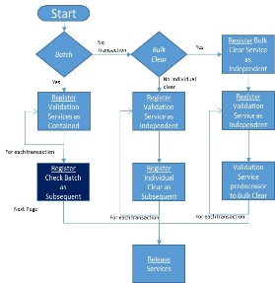
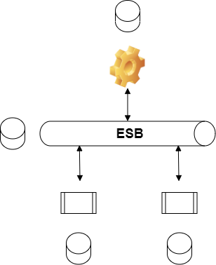
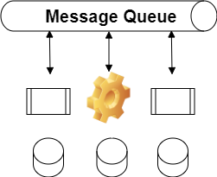
Design Patterns
Synchronous
Asynchronous
Smart Pipes
BPM coordination
T
Dumb Pipes
Tools Required

Slide 4
Run Time Coordination of “Mini” Services
Today, may companies run on business applications that are large “monolithic” programs. To embrace and realize the promise and benefits of the cloud revolution (scalability, redundancy, reuse, to name a few), in many circumstances a business finds itself in a position of having to deconstruct those monolithic programs.
However, the resources available to the company may not be well versed with the new cloud technologies. Nevertheless, the business may have deep domain expertise of the business processes contained within those monolithic programs.
A simple runtime coordination platform for mini services would provide those companies with a practical way forward.
Subject matter experts, with simple “if then else” flow logic, can document those process flows. Developers who are trained in creating simple HTTP post interfaces can take those process designs and create mini services, while at the same time coordinating the business process flow. The platform would control the state of the process execution and the instantiation of the mini services, while providing visibility into the execution of the business process.
The platform ideally should allow those mini services to run on various state of the art cloud platforms.

Slide 5
Business value example
Take a file based payments processing system, for example, the processing of each payment request proceeds through a very complex business flow. For example, some clients may want to fail an entire file if one transaction is syntactically incorrect. Other clients may want all transactions that are valid to be processed and only those that fail should be rejected. Similarly, one client may want to fail the entire file if one transaction is a duplicate to a previous transaction, while another may want the non-duplicates to be processes. In a real world system, there are hundreds of client options.
Furthermore, the processing flow may vary depending on the data within the transaction. For example, a payment from one country may have different validation rules than a payment from another.
Todays monolithic programs are quite complex. Decomposing them into mini services is a daunting task. However a simple run time service coordinator may provide a path forward.

Slide 6
Runtime Coordination Platform Prototype
Input into the runtime platform is quite simple. A mini service can “chain” calls to other mini services to complete a business process flow.
The platform has 3 (4?) types of chains creation formats:
A “root” service. A service that is the root of a new tree.
An “independent” service. One service can “fork off” another service that will run independently (of course that service can create its own processing chains).
A “contained” service. A service that creates “contained” services will not complete (and subsequent services will not start) until all contained services are completed.
A “subsequent” service. The subsequent service will not start until the creating service is complete.
A “final” service. The final service will be executed after its creator, and all the creator’s descendants are finished.

Slide 7
Runtime Coordination Platform Prototype
To chain a service, all that is required is the URL of the service and an optional parameter that is passed into the service.
When a service is instantiated by the platform, it has access to the parameter, as well as a UUID that is unique to that service, the UUID of its creating service, and the UUID of the root service.
This structure can be implemented as a tree. The tree structure (root, parent, service) is defined in section #.#.
These UUIDs are unique, and can be used in any business process utilizing the platform. For example, the root id is used by the sample file payments processing system defined later as the file ID. Similarly, the UUID of the validation service for each transaction is used as the transaction ID in the prototype system.
Using the root id in this way is beneficial as the root UUID is used as a partitioning ID in the underlying platform database.

Slide 8
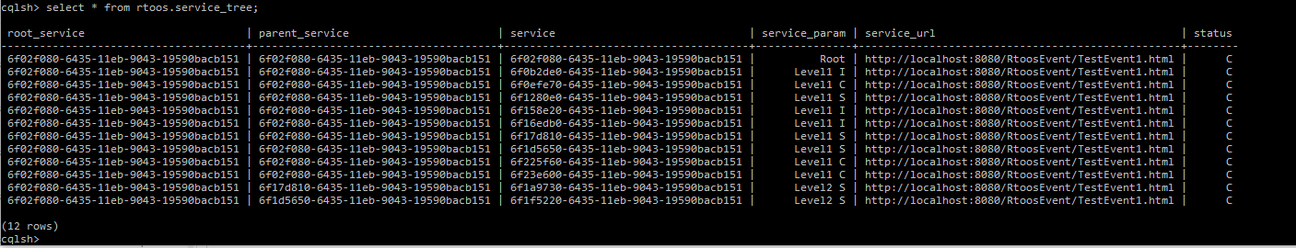
Tree structure
As services are created, they naturally form a tree structure. The complete web can be structured in a database as a table of 3 entries:
The Root service
The Parent Service
The Service
The platform assigns each service a UID, and that is located in the third column. The first service in the web is naturally the root service. In the prototype, a root can be identified as have the same UID in all 3 columns.
When a service creates another service, the creating service is stored in the Parent Service column.

Slide 9
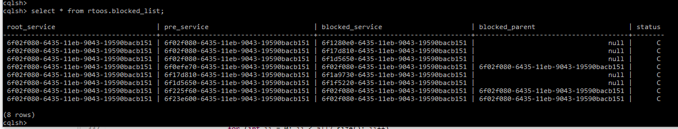
Service Tree structure
The coordination prototype has a second table that maintains the services that are blocked and/or waiting to be instantiated.
The table also contains the root_service, and while it is not used to process the waiting files, it is also used as a portioning key so all entries for any individual web are partitioned the same by the database.

Slide 10
Sample business process
Discussion of system, and sample business process here.

Slide 11
Sample Business Process – Customer Options
The following sample business process demonstrates most of the capabilities of the coordination engine. The business process is a very simple file processing service that contains 2 customer options:
If a line in the file fails authentication:
Fail the entire file “Batch” value for the “Authenticate” name in the input JSON
Fail just that transaction “Transaction” value for the “Authenticate” name in the input JSON
When the service “clears” the file (actually transfers the money):
Credit the customer’s account for each transaction (each transaction is a totally separate transaction) “Individual” value for the “Clearing” name in the JSON input
Credit the customer’s account once for the total of all the transactions (i.e., if a file has 3 transactions of 1000, the customer’s account would be credited once for 3000 and each payee would be debited for 1000) “Bulk” value for the “Clearing” name in the JSON input

Slide 12
Sample Business Process – Processing
The sample business process has one very simple authentication rules:
Accounts must be numeric
The input file contains 3 columns, the from account, the to account, and the amount: 1111,2222,1000 - valid 111a,2222,1000 - invalid 2222,3333,1000 - valid 2222,333b,1000 – invalid
The following diagrams highlight the flow of the 2 services that interact with the coordination system:
The first is the file import service
The second is the Check Batch service (one of the services created in the file input service)

Slide 13
Sample File Import Controller
Start
Persist file to data store: use the root ID as the file ID and use a R2 generated ID as each transaction ID
Customer Option Batch?
Register Batch controller as subsequent service
Customer Option Transaction?
Register Transaction Controller as subsequent service
Register a “final” service to call when entire tree is complete
Release the services
Persist file to data store
Batch
No Transaction
Trans
No error
Fail File
Yes
Yes
Register Batch controller as subsequent
Register trans controller as subsequent
Register
Final service
Release Services

Slide 14
Sample Batch Controller
Start
Register the batch evaluation service as subsequent
For each transaction register a validation service as contained
use root id to get file from data store,
use transaction id from data store as the service id
Register Eval Batch worker as subsequent
Register Validation trans as Contained
For each transaction
Release Services

Slide 15
Sample Evaluate Batch Service
Start
Check to see if all transactions were valid?
No, fail the file
Bulk Clear: Create a new bulk clear service
Individual Clear: Create an individual clear service for each transaction
All Valid
No
Fail File
Yes
Bulk Clear
New Bulk Clear Service
as Independent
Yes
No
New individual clear as Independent
For each transaction

Slide 16
Sample Transaction Controller
Start
Customer Option Bulk Clear
Register Bulk Clear service as subsequent service
Register validation service as contained for each transaction
Customer Option Individual Clear?
For each transaction:
Register validation service as independent
Register individual clear service as subsequent to validation
Bulk
No Individual
Indiv
Yes
Yes
Register Bulk Clear as subsequent
Register validation as independent
Register Validation trans as Contained
Register clear individual as sub to val
For each transaction
For each transaction
Release Services

Slide 17
Sample Business Process – Conclusion
As demonstrated with this simple business process with 2 client options, a platform that requires the process flow to be defined at runtime would require 3 or 4 (depending on how they were coded) process models
With the new platform, the process can be developed with a few if statements
In real payment processing systems, there are hundreds of customer options, as well as countless processing rules based upon the data contained in the payment instruction. With simple flow charts created by business analysists, developers can create mini services. These mini services can then be run on the platform utilizing the state of the art cloud services totally transparent to the developers of the system.

Slide 18
Sample Business Process – Set up
The demo was created using Java and eclipse on windows
The database was Cassandra – to set up Cassandra I followed the instructions: Install Cassandra on Windows 10: Tutorial With Simple Steps (phoenixnap.com)
To use cqlsh to query the Cassandra tables directly, I installed anaconda. cqlsh uses python 2.7, so I had to create an anaconda environment with python 2.7 to use cqlsh:
open anaconda prompt
activate mlb27 (I had to create an environment with python 2.7)
start cqlsh
If you wish to recreate the tables:
CREATE KEYSPACE IF NOT EXISTS rtoos WITH replication = {'class': 'SimpleStrategy', 'replication_factor': '1'} AND durable_writes = true;
CREATE TABLE rtoos.service_tree (root_service UUID, parent_service UUID, service UUID, service_url text, service_param text, status text, PRIMARY KEY((root_service), parent_service, service));
CREATE index service_id on rtoos.service_tree(service);CREATE TABLE rtoos.blocked_list (root_service UUID, pre_service UUID, blocked_service UUID, blocked_parent UUID, status text, PRIMARY KEY((root_service), pre_service, blocked_service));
CREATE index blocked_id on rtoos.blocked_list(blocked_service);

Slide 19
Sample Business Process – Demo
To demonstrate the prototype:
Start Cassandra
Start eclipse
Start to server on the server tab
Use postman to send an HTTP Post to http://localhost:8080/RtoosEvent/FileAdapter.html using the body {"rtoos_msg" : {"type" : "ImportFile", "FileName" : "c:\\input.csv", "Authenticate" : "Transaction", "Clearing" : "Individual"}}
of course either “Transaction” or “Batch” can be used for Authenticate and “Individual” or “Bulk” can be used for Clearing

